Slide 1
Neural Networks

Slide 2
What are neural networks?
Neural networks (NN), also called artificial neural networks (ANN), are a particular class of machine learning systems. Their structure replicates the biological neural networks that compose the animal brain.

Slide 3
What are neural networks?
Neural networks are used for many predictive tasks, including time series forecasting. They can handle complex relationships between input and output variables.
Drawback: they are “black box” systems, so the model relationships are pretty hard to describe and understand.

Slide 4
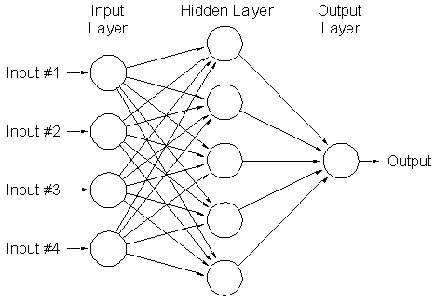
What are neural networks?

Slide 5
What are neural networks?
Basic structure of a neural netowrk
An input layer, that contains the values of the predictors.
One or more hidden layers. A hidden takes the inputs from the previous layers, apply some transformations to them and passes the output to the next layers.
The output layer contains the predicted values, computed based on the inputs received from the hidden layers.

Slide 6
What are neural networks?
In each node of the hidden layers, two operations are applied to the input values:
summation, that is, performing a weighted sum of the input values
activation: an activation function is applied to the sum.
The most common types of activation functions are:
linear
exponential
logit
tangential hyperbolic

Slide 7
Model Preparation

Slide 8
Model preparation
Create derived predictors, i.e lagged versions of the time series (just as we did for the ARIMA models). These variables will be the inputs of our neural network.

Slide 9
Model preparation
Remove the missing values in our derived predictors. Lagged variables have missing values in the first rows (for example, a 3-order lag has 3 missing values). We must eliminate all the rows with missing values before proceeding to the analysis.

Slide 10
Model preparation
Scale variables. Neural networks work better when the values of the input variables are between 0 and 1, or between -1 and 1. So we have to apply some scaling method to the initial values.

Slide 11
Model preparation
Remove trend and seasonality. Practice has shown that the network performance is better when the series is de-trended and de-seasonalized. Techniques like exponential smoothing, regression, logarithms etc. are employed at this step.

Slide 12
Model preparation
Other decisions concern:
the number of hidden layers (usually 1-2 layers are enough, too many hidden layers can lead to overfitting)
the number of nodes in the hidden layers (this is a matter of trial and error)
the activation function (the most common activation functions are the s-shaped, e.g. logit or hyperbolic tangent)

Slide 13
The nnetar() Function

Slide 14
The nnetar() function
The nnetar() function can be used to build neural networks for time series forecasting.

Slide 15
The nnetar() function
This function does all the data pre-processing work automatically:
creates lag variables (derived predictors)
removes rows with missing values
scales the predictors
removes trend and seasonality (and brings them back into the series when making forecasts)

Slide 16
The nnetar() function
Arguments:
p – the number of non-seasonal lags included in the model. The default value of this parameter is the number of lags for a linear AR(p) model. So we can let the program set this argument for us.
P – the number of seasonal lags. The most common values are 1 for seasonal time series and zero for non-seasonal ones.
size – number of nodes in the hidden layer (the nnetar function builds networks with one hidden layer). The default value is the number of input variables plus 1.
repeats – number of networks to be built with different random starting weights. The default is 20. The outputs of these networks are averaged to produce the forecasts.

